Slide 1
Tutorial 10 Union-Find, Minimum Spanning Trees
Slides Adapted From:
Jason Christopher (@jasonc21)
jason.christopher@u.nus.edu

Slide 2
Check In
PS7

Slide 3
Quick Recap!
Union Find + Weighted Union + Path Compression

Slide 4
Quick Find (Disjoint Sets)
Goal: Optimise Find
Element
A
B
C
D
E
F
G
H
Component
-
-
-
-
-
-
-
-

Slide 5
Quick Find (Disjoint Sets)
Goal: Optimise Find
Element
A
B
C
D
E
F
G
H
Component
1
1
1
2
2
2
-
-
Suppose I have set 1 = {A, B, C}, set 2 = {D, E, F}

Slide 6
Quick Find (Disjoint Sets)
Goal: Optimise Find
Element
A
B
C
D
E
F
G
H
Component
1
1
1
2
2
2
-
-
Union(A, D)?

Slide 7
Quick Find (Disjoint Sets)
Goal: Optimise Find
Element
A
B
C
D
E
F
G
H
Component
2
2
2
2
2
2
-
-
Update the component IDs!

Slide 8
Quick Find (Disjoint Sets)
Goal: Optimise Find
Element
A
B
C
D
E
F
G
H
Component
2
2
2
2
2
2
-
-
Find(A, D)?

Slide 9
Quick Find (Disjoint Sets)
Goal: Optimise Find
Check component ID of A and D, if the same then they are in the same set.
Find(A, D)?
A
D
2
2

Slide 10
Quick Find (Disjoint Sets)
Goal: Optimise Find
Runtime: Union = O(n), Find = O(1)

Slide 11
Quick Union (Disjoint Sets)
Goal: Optimise Union
Element
A
B
C
D
E
F
G
H
Parent
A
A
B
E
E
E
-
-
Union(C, D)?

Slide 12
Quick Union (Disjoint Sets)
Goal: Optimise Union
Element
A
B
C
D
E
F
G
H
Parent
A
A
B
E
E
E
-
-
Check the last parent of the elements

Slide 13
Quick Union (Disjoint Sets)
Goal: Optimise Union
Element
A
B
C
D
E
F
G
H
Parent
A
A
B
E
E
E
-
-
Check the last parent of the elements

Slide 14
Quick Union (Disjoint Sets)
Goal: Optimise Union
Element
A
B
C
D
E
F
G
H
Parent
A
A
B
E
E
E
-
-
Check the last parent of the elements

Slide 15
Quick Union (Disjoint Sets)
Goal: Optimise Union
Element
A
B
C
D
E
F
G
H
Parent
A
A
B
E
E
E
-
-
Then set the parent of one element to another

Slide 16
Quick Union (Disjoint Sets)
Goal: Optimise Union
Element
A
B
C
D
E
F
G
H
Parent
E
A
B
E
E
E
-
-
Then set the parent of one element to another

Slide 17
Quick Union (Disjoint Sets)
Goal: Optimise Union
Element
A
B
C
D
E
F
G
H
Parent
E
A
B
E
E
E
-
-
Find(C, D)?

Slide 18
Quick Union (Disjoint Sets)
Goal: Optimise Union
Element
A
B
C
D
E
F
G
H
Parent
E
A
B
E
E
E
-
-
Check the very last parent of C and D

Slide 19
Quick Union (Disjoint Sets)
Goal: Optimise Union
Element
A
B
C
D
E
F
G
H
Parent
E
A
B
E
E
E
-
-
Check the very last parent of C and D
Last parent of C = E, last parent of D = E. They are in the same component

Slide 20

Quick Union (Disjoint Sets)
Goal: Optimise Union
Runtime: Union = O(n), Find = O(n)

Slide 21
Quick Union (Disjoint Sets)
Goal: Optimise Union
Runtime: Union = O(n), Find = O(n)
Implementation is similar to traversing the path from a node to root in a binary tree
Expect O(log n), but in worst case, if not height balanced, then O(n)

Slide 22
Quick Union (Disjoint Sets)
Goal: Optimise Union
Runtime: Union = O(n), Find = O(n)
Implementation is similar to traversing the path from a node to root in a binary tree
Expect O(log n), but in worst case, if not height balanced, then O(n)

Slide 23
Weighted Union
Goal: Quick Union but Height Balanced
Merge the component with less elements to the component with more elements
Key Idea: height only increases when total size doubles

Slide 24
Weighted Union
Goal: Quick Union but Height Balanced
Merge the component with less elements to the component with more elements
Key Idea: height only increases when total size doubles
Runtime: O(log n) for both union and find

Slide 25
Path Compression
Goal: Reduce Height
During Find, connect each parent directly to root

Slide 26
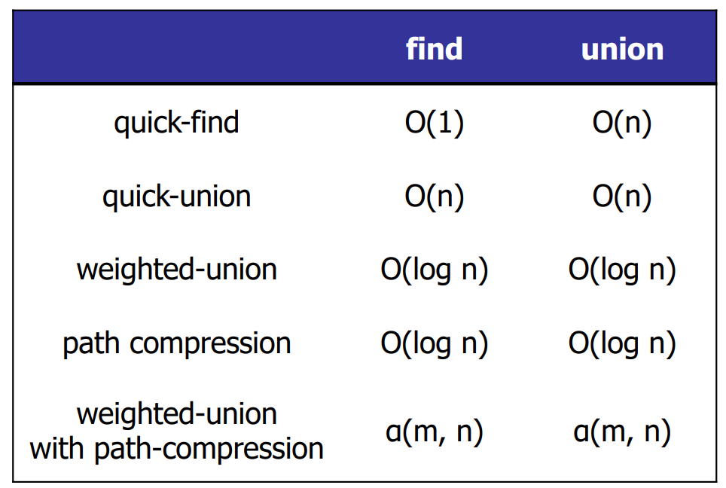

Slide 27
2. MST Review
Can you use the cycle and cut property of to determine
which edges must be in the MST?
3
E
A
5
2
4
C
F
2
4
3
3
B
D
G
3
2

Slide 28
2. MST Review
Cycle Property:
3
E
A
5
2
4
C
F
2
4
3
3
B
D
G
3
2

Slide 29
2. MST Review
Cycle Property:
Inspect cycle A-C-E
3
E
A
5
2
4
C
F
2
4
3
3
B
D
G
3
2

Slide 30
2. MST Review
Cycle Property:
Max weight won’t be at MST, remove edge 4
3
E
A
5
2
4
C
F
2
4
3
3
B
D
G
3
2

Slide 31
2. MST Review
Cycle Property:
Inspect cycle E-C-D-F
3
E
A
5
2
4
C
F
2
4
3
3
B
D
G
3
2

Slide 32
2. MST Review
Cycle Property:
Max weight won’t be in MST, remove E-F
3
E
A
5
2
4
C
F
2
4
3
3
B
D
G
3
2

Slide 33
2. MST Review
Cycle Property:
Inspect cycle D-F-G
3
E
A
5
2
4
C
F
2
4
3
3
B
D
G
3
2

Slide 34
2. MST Review
Cycle Property:
Max weight won’t be in MST, remove D-F
3
E
A
5
2
4
C
F
2
4
3
3
B
D
G
3
2

Slide 35
2. MST Review
Cycle Property:
Inspect cycle A-B-D-C-E
3
E
A
5
2
4
C
F
2
4
3
3
B
D
G
3
2

Slide 36
2. MST Review
Cycle Property:
Max weight won’t be in cycle
3
E
A
5
2
4
C
F
2
4
3
3
B
D
G
3
2

Slide 37
2. MST Review
Cycle Property:
Remove any edge with weight 3
3
E
A
5
2
4
C
F
2
4
3
3
B
D
G
3
2

Slide 38
2. MST Review
First MST – Removing A-E:
3
E
A
5
2
4
C
F
2
4
3
3
B
D
G
3
2

Slide 39
2. MST Review
Second MST - Removing C-D:
3
E
A
5
2
4
C
F
2
4
3
3
B
D
G
3
2

Slide 40
2. MST Review
Third MST - Removing B-D:
3
E
A
5
2
4
C
F
2
4
3
3
B
D
G
3
2

Slide 41
2. MST Review
Cut Property:
For every partition of the nodes, edge with
minimum weight across cut is in the MST.
3
E
A
5
2
4
C
F
2
4
3
3
B
D
G
3
2

Slide 42
2. MST Review
Cut Property:
Simple Partition: Create partition of each node
3
E
A
5
2
4
C
F
2
4
3
3
B
D
G
3
2

Slide 43
2. MST Review
Cut Property:
Partition E alone
E
3
A
5
2
4
C
F
2
4
3
3
B
D
G
3
2

Slide 44
2. MST Review
Cut Property:
Keep edge C-E with minimum weight 2
E
3
A
5
2
4
C
F
2
4
3
3
B
D
G
3
2

Slide 45
2. MST Review
Cut Property:
One edge added!
3
E
A
5
2
4
C
F
2
4
3
3
B
D
G
3
2

Slide 46
2. MST Review
Cut Property:
Partition A alone
3
E
A
5
2
4
C
F
2
4
3
3
B
D
G
3
2

Slide 47
2. MST Review
Cut Property:
Keep edge A-B with minimum weight 2
3
E
A
5
2
4
C
F
2
4
3
3
B
D
G
3
2

Slide 48
2. MST Review
Cut Property:
2 edges added!
3
E
A
5
2
4
C
F
2
4
3
3
B
D
G
3
2

Slide 49
2. MST Review
Cut Property:
Partition F alone
3
E
A
5
2
4
C
F
2
4
3
3
B
D
G
3
2

Slide 50
2. MST Review
Cut Property:
Keep edge F-G with minimum weight 3
3
E
A
5
2
4
C
F
2
4
3
3
B
D
G
3
2

Slide 51
2. MST Review
Cut Property:
3 edges added!
3
E
A
5
2
4
C
F
2
4
3
3
B
D
G
3
2

Slide 52
2. MST Review
Cut Property:
Partition D alone
3
E
A
5
2
4
C
F
2
4
3
3
B
D
G
3
2

Slide 53
2. MST Review
Cut Property:
Keep edge D-G with minimum weight 2
3
E
A
5
2
4
C
F
2
4
3
3
B
D
G
3
2

Slide 54
2. MST Review
Cut Property:
4 edges added!
3
E
A
5
2
4
C
F
2
4
3
3
B
D
G
3
2

Slide 55
2. MST Review
Cut Property:
But still separate components :v
3
E
A
5
2
4
C
F
2
4
3
3
B
D
G
3
2

Slide 56
2. MST Review
Cut Property:
Partition {A, B} apart from others
3
E
A
5
2
4
C
F
2
4
3
3
B
D
G
3
2

Slide 57
2. MST Review
Cut Property:
Edge with minimum weight is in MST
3
E
A
5
2
4
C
F
2
4
3
3
B
D
G
3
2

Slide 58
2. MST Review
Cut Property:
Case A-E in MST
3
E
A
5
2
4
C
F
2
4
3
3
B
D
G
3
2

Slide 59
2. MST Review
Cut Property:
5 edges added to MST
Case: A-E in MST
3
E
A
5
2
4
C
F
2
4
3
3
B
D
G
3
2

Slide 60
2. MST Review
Cut Property:
Partition {A, B, C, E} and {D, F, G}
Case: A-E in MST
3
E
A
5
2
4
C
F
2
4
3
3
B
D
G
3
2

Slide 61
2. MST Review
Cut Property:
Minimum weight edge is in MST
Case: A-E in MST
3
E
A
5
2
4
C
F
2
4
3
3
B
D
G
3
2

Slide 62
2. MST Review
Cut Property:
Two cases: B-D in MST
Case: A-E in MST
3
E
A
5
2
4
C
F
2
4
3
3
B
D
G
3
2

Slide 63
2. MST Review
Cut Property:
Two cases: or C-D in MST
Case: A-E in MST
3
E
A
5
2
4
C
F
2
4
3
3
B
D
G
3
2

Slide 64
2. MST Review
Cut Property:
Let’s look at case where A-E is not in MST
Case: A-E in MST
3
E
A
5
2
4
C
F
2
4
3
3
B
D
G
3
2

Slide 65
2. MST Review
Cut Property:
Case A-E in MST
3
E
A
5
2
4
C
F
2
4
3
3
B
D
G
3
2

Slide 66
2. MST Review
Cut Property:
Case B-D in MST
3
E
A
5
2
4
C
F
2
4
3
3
B
D
G
3
2

Slide 67
2. MST Review
Cut Property:
5 edges added to MST
Case: B-D in MST
3
E
A
5
2
4
C
F
2
4
3
3
B
D
G
3
2

Slide 68
2. MST Review
Cut Property:
Partition {C, E} and {A, B, D, F, G}
Case: B-D in MST
3
E
A
5
2
4
C
F
2
4
3
3
B
D
G
3
2

Slide 69
2. MST Review
Cut Property:
Minimum edge across cut in MST
Case: B-D in MST
3
E
A
5
2
4
C
F
2
4
3
3
B
D
G
3
2

Slide 70
2. MST Review
Cut Property:
Two cases: A-E in MST (similar to seen before)
Case: B-D in MST
3
E
A
5
2
4
C
F
2
4
3
3
B
D
G
3
2

Slide 71
2. MST Review
Cut Property:
Two cases: or C-D in MST
Case: B-D in MST
3
E
A
5
2
4
C
F
2
4
3
3
B
D
G
3
2

Slide 72
2. MST Review
Result MST same for both Cycle and Cut Property
(3 possible MSTs)
3
E
A
5
2
4
C
F
2
4
3
3
B
D
G
3
2

Slide 73
2. MST Review
Perform Prim’s, Kruskal’s, and Boruvka’s algorithm!
3
E
A
5
2
4
C
F
2
4
3
3
B
D
G
3
2

Slide 74
Prim’s:
Start from a node (e.g. node A)
Priority Queue:
3
E
A
5
2
4
C
F
2
4
3
3
B
D
G
3
2

Slide 75
Prim’s:
Add outgoing edges to PQ
Priority Queue:
B
2
E
3
C
4
3
E
A
5
2
4
C
F
2
4
3
3
B
D
G
3
2

Slide 76
Prim’s:
Dequeue node from PQ
Priority Queue:
B
2
E
3
C
4
3
E
A
5
2
4
C
F
2
4
3
3
B
D
G
3
2

Slide 77
Prim’s:
Dequeue node from PQ
Priority Queue:
E
3
C
4
3
E
A
5
2
4
C
F
2
4
3
3
B
D
G
3
2

Slide 78
Prim’s:
Update outgoing edges to PQ
Priority Queue:
D
3
E
3
C
4
3
E
A
5
2
4
C
F
2
4
3
3
B
D
G
3
2

Slide 79
Prim’s:
Dequeue node from PQ
Priority Queue:
E
3
C
4
3
E
A
5
2
4
C
F
2
4
3
3
B
D
G
3
2

Slide 80
Prim’s:
Update outgoing edges to PQ
Priority Queue:
G
2
C
3
E
3
F
4
3
E
A
5
2
4
C
F
2
4
3
3
B
D
G
3
2

Slide 81
Prim’s:
Dequeue node from PQ
Priority Queue:
C
3
E
3
F
4
3
E
A
5
2
4
C
F
2
4
3
3
B
D
G
3
2

Slide 82
Prim’s:
Update outgoing edges to PQ
Priority Queue:
C
3
E
3
F
3
3
E
A
5
2
4
C
F
2
4
3
3
B
D
G
3
2

Slide 83
Prim’s:
Dequeue node from PQ
Priority Queue:
E
3
F
3
3
E
A
5
2
4
C
F
2
4
3
3
B
D
G
3
2

Slide 84
Prim’s:
Update outgoing edges
Priority Queue:
E
2
F
3
3
E
A
5
2
4
C
F
2
4
3
3
B
D
G
3
2

Slide 85
Prim’s:
Dequeue node
Priority Queue:
F
3
3
E
A
5
2
4
C
F
2
4
3
3
B
D
G
3
2

Slide 86
Prim’s:
Update outgoing edges
Priority Queue:
F
3
3
E
A
5
2
4
C
F
2
4
3
3
B
D
G
3
2

Slide 87
Prim’s:
Dequeue node
Priority Queue:
3
E
A
5
2
4
C
F
2
4
3
3
B
D
G
3
2

Slide 88
Prim’s:
Terminate algorithm
Priority Queue:
E
A
2
C
F
2
3
3
B
D
G
3
2

Slide 89
Kruskal’s:
Sort all edges
3
E
A
5
2
4
C
F
2
4
3
3
B
D
G
3
2

Slide 90
Kruskal’s:
Sort all edges
A-B
2
C-E
2
D-G
2
A-E
3
B-D
3
C-D
3
F-G
3
A-C
4
D-F
4
E-F
5
3
E
A
5
2
4
C
F
2
4
3
3
B
D
G
3
2

Slide 91
Kruskal’s:
Pop each edge, if doesn’t form cycle, add to MST
C-E
2
D-G
2
A-E
3
B-D
3
C-D
3
F-G
3
A-C
4
D-F
4
E-F
5
3
E
A
5
2
4
C
F
2
4
3
3
B
D
G
3
2

Slide 92
Kruskal’s:
Pop each edge, if doesn’t form cycle, add to MST
D-G
2
A-E
3
B-D
3
C-D
3
F-G
3
A-C
4
D-F
4
E-F
5
3
E
A
5
2
4
C
F
2
4
3
3
B
D
G
3
2

Slide 93
Kruskal’s:
Pop each edge, if doesn’t form cycle, add to MST
A-E
3
B-D
3
C-D
3
F-G
3
A-C
4
D-F
4
E-F
5
3
E
A
5
2
4
C
F
2
4
3
3
B
D
G
3
2

Slide 94
Kruskal’s:
Pop each edge, if doesn’t form cycle, add to MST
B-D
3
C-D
3
F-G
3
A-C
4
D-F
4
E-F
5
3
E
A
5
2
4
C
F
2
4
3
3
B
D
G
3
2

Slide 95
Kruskal’s:
Pop each edge, if doesn’t form cycle, add to MST
C-D
3
F-G
3
A-C
4
D-F
4
E-F
5
3
E
A
5
2
4
C
F
2
4
3
3
B
D
G
3
2

Slide 96
Kruskal’s:
Pop each edge, if doesn’t form cycle, add to MST
F-G
3
A-C
4
D-F
4
E-F
5
3
E
A
5
2
4
C
F
2
4
3
3
B
D
G
3
2

Slide 97
Kruskal’s:
Pop each edge, if doesn’t form cycle, add to MST
A-C
4
D-F
4
E-F
5
3
E
A
5
2
4
C
F
2
4
3
3
B
D
G
3
2

Slide 98
Kruskal’s:
Pop each edge, if doesn’t form cycle, add to MST
3
E
A
5
2
4
C
F
2
4
3
3
B
D
G
3
2

Slide 99
Boruvka’s
For each node, add the minimally adjacent edge
3
E
A
5
2
4
C
F
2
4
3
3
B
D
G
3
2

Slide 100
Boruvka’s
For each node, add the minimally adjacent edge
Cut property on individual nodes
3
E
A
5
2
4
C
F
2
4
3
3
B
D
G
3
2

Slide 101
Boruvka’s
It now forms 3 connected components
3
E
A
5
2
4
C
F
2
4
3
3
B
D
G
3
2

Slide 102
Boruvka’s
For each connected component, search
for the minimal outgoing edge:
3
E
A
5
2
4
C
F
2
4
3
3
B
D
G
3
2

Slide 103
Boruvka’s
For each connected component, search
for the minimal outgoing edge:
3
E
A
5
2
4
C
F
2
4
3
3
B
D
G
3
2

Slide 104
Boruvka’s
For each connected component, search
for the minimal outgoing edge:
3
E
A
5
2
4
C
F
2
4
3
3
B
D
G
3
2

Slide 105
Boruvka’s
For each connected component, search
for the minimal outgoing edge:
3
E
A
5
2
4
C
F
2
4
3
3
B
D
G
3
2

Slide 106
Boruvka’s
For each connected component, search
for the minimal outgoing edge:
3
E
A
5
2
4
C
F
2
4
3
3
B
D
G
3
2

Slide 107
Boruvka’s
For each connected component, search
for the minimal outgoing edge:
3
E
A
5
2
4
C
F
2
4
3
3
B
D
G
3
2

Slide 108
Boruvka’s
For each connected component, search
for the minimal outgoing edge:
3
E
A
5
2
4
C
F
2
4
3
3
B
D
G
3
2

Slide 109
Boruvka’s
For each connected component, search
for the minimal outgoing edge:
3
E
A
5
2
4
C
F
2
4
3
3
B
D
G
3
2

Slide 110
Boruvka’s
Result: MST!
3
E
A
5
2
4
C
F
2
4
3
3
B
D
G
3
2

Slide 111
2. MST Review
A Fibonacci heap is a priority queue that implements insert, delete, and decreaseKey in O(1) amortized time, and implements extractMin in O(log n) amortized time,
assuming n elements in the heap.
If you run Prim’s Algorithm on a graph of V nodes and E edges using a Fibonacci Heap, what is the running time?

Slide 112
2. MST Review
Prim’s Algorithm:

Slide 113
2. MST Review
There can only be a maximum of V – 1 nodes at the priority queue!
→ Extract min can only be called max. V times
However, we need to update the PQ for every edge traversed
→ Update (insert / decreaseKey) will be called for E times

Slide 114
2. MST Review
Runtime:
V extractMin operations + E insert/decreaseKey operations
V x O(log V) + E x O(1)
= O(E + V log V)

Slide 115
4. Power Plant
Given a network of power plants, houses and potential cables to be laid, along with its associated cost, find the cheapest way to connect every house to at least one power plant. The connections can be routed through other houses if required.
4
6
3
B
D
F
H
5
7
4
11
5
5
8
A
C
E
G
I
2
4
10
10

Slide 116
4. Power Plant
Given a network of power plants, houses and potential cables to be laid, along with its associated cost, find the cheapest way to connect every house to at least one power plant. The connections can be routed through other houses if required.
4
6
3
B
D
F
H
5
7
4
11
5
5
8
A
C
E
G
I
2
4
10
10

Slide 117
4. Power Plant
Run MST only? The graphs need not be connected!
4
6
3
B
D
F
H
5
7
4
11
5
5
8
A
C
E
G
I
2
4
10
10

Slide 118
4. Power Plant
Idea: Want to find MST but no need to be connected
As long as each house is connected to one power plant
4
6
3
B
D
F
H
5
7
4
11
5
5
8
A
C
E
G
I
2
4
10
10

Slide 119
Idea: Create a “Super power plant!”, connect to each power plant with weight zero
S
4
6
3
B
D
F
H
5
7
4
11
5
5
8
A
C
E
G
I
2
4
10
10

Slide 120
Idea: Create a “Super power plant!”, connect to each power plant with weight zero
0
0
S
0
4
6
3
B
D
F
H
5
7
4
11
5
5
8
A
C
E
G
I
2
4
10
10

Slide 121
Find the MST of this new Graph!
0
0
S
0
4
6
3
B
D
F
H
5
7
4
11
5
5
8
A
C
E
G
I
2
4
10
10

Slide 122
Find the MST of this new Graph!
e.g. Kruskal:
0
0
S
0
4
6
3
B
D
F
H
5
7
4
11
5
5
8
A
C
E
G
I
2
4
10
10

Slide 123
Find the MST of this new Graph!
e.g. Kruskal:
0
0
S
0
4
6
3
B
D
F
H
5
7
4
11
5
5
8
A
C
E
G
I
2
4
10
10

Slide 124
Find the MST of this new Graph!
e.g. Kruskal:
0
0
S
0
4
6
3
B
D
F
H
5
7
4
11
5
5
8
A
C
E
G
I
2
4
10
10

Slide 125
Find the MST of this new Graph!
e.g. Kruskal:
0
0
S
0
4
6
3
B
D
F
H
5
7
4
11
5
5
8
A
C
E
G
I
2
4
10
10

Slide 126
Find the MST of this new Graph!
e.g. Kruskal:
0
0
S
0
4
6
3
B
D
F
H
5
7
4
11
5
5
8
A
C
E
G
I
2
4
10
10

Slide 127
Find the MST of this new Graph!
e.g. Kruskal:
0
0
S
0
4
6
3
B
D
F
H
5
7
4
11
5
5
8
A
C
E
G
I
2
4
10
10

Slide 128
Find the MST of this new Graph!
e.g. Kruskal:
0
0
S
0
4
6
3
B
D
F
H
5
7
4
11
5
5
8
A
C
E
G
I
2
4
10
10

Slide 129
Find the MST of this new Graph!
e.g. Kruskal:
0
0
S
0
4
6
3
B
D
F
H
5
7
4
11
5
5
8
A
C
E
G
I
2
4
10
10

Slide 130
Find the MST of this new Graph!
e.g. Kruskal:
0
0
S
0
4
6
3
B
D
F
H
5
7
4
11
5
5
8
A
C
E
G
I
2
4
10
10

Slide 131
Remove the “super power plant”, and we got the solution!
0
0
S
0
4
6
3
B
D
F
H
5
7
4
11
5
5
8
A
C
E
G
I
2
4
10
10

Slide 132
4. Power Plant
Solution:
Create “super power plant”
Run any MST algorithm
Runtime: O(E log V) [standard for Prim/Kruskal/Boruvka]
4
6
3
B
D
F
H
5
7
4
11
5
5
8
A
C
E
G
I
2
4
10
10

Slide 133
4. Power Plant
Alternative solution (Implementation-focused):
Modify the starting conditions for the MST algorithms to include all power plants at the beginning
4
6
3
B
D
F
H
5
7
4
11
5
5
8
A
C
E
G
I
2
4
10
10

Slide 134
Tutorial Problems
Union-Find, MSTs

Slide 135
3. Horseplay
There are m bales of hay and n horses to buck them.
The i^{th} bale of hay has a weight of k_{i} kilograms.
The i^{th} horse has a strength s_{i} = maximum weight it can buck, and can be hired for d_{i} dollars.
Every horse can buck at most one bale of hay. Determine, in O(nlogn + mlogm), the minimum amount in dollars needed to buck all bales of hay. If it is not possible, determine that as well.

Slide 136
3. Horseplay
There are m bales of hay and n horses to buck them.
The i^{th} bale of hay has a weight of k_{i} kilograms.
The i^{th} horse has a strength s_{i} = maximum weight it can buck, and can be hired for d_{i} dollars.
Every horse can buck at most one bale of hay. Determine, in O(nlogn + mlogm), the minimum amount in dollars needed to buck all bales of hay. If it is not possible, determine that as well.
Implies that we need to do some sorting!

Slide 137
3. Horseplay
Sort hay by non-increasing weight, and sort horses by non-increasing strength
For the first bale of hay with weight k₁, figure out initial set of horses that can buck it (find largest j for which s_{j} >= k₁)
Add these horses into a minimum PQ, where priority = price. Then dequeue the cheapest horse.
Repeat this process for every subsequent bale of hay.

Slide 138
3. Horseplay
If, at any point, the priority queue is empty, but we have a bale of hay to buck, then it is impossible. (we can’t find a horse that is strong enough to buck it!)
Runtime: O(nlogn + mlogm) for sorting hay and horses. O(mlogm) for running at most m insertions and at most n extracts from a priority queue of size m. Overall = O(nlogn + mlogm) (either term may dominate depending on size of m or n)

Slide 139
1. Union-Find Review
What is the worst-case running time of the find operation in Union-Find with path compression (but no weighted union i.e Quick-Union with past compression)?

Slide 140
1. Union-Find Review
1
2
3
4
5

Slide 141
1. Union-Find Review
1
2
3
4
5

Slide 142
1. Union-Find Review
Union (1, 2)
1
2
3
4
5

Slide 143
1. Union-Find Review
Union (2, 3)
1
2
3
4
5

Slide 144
1. Union-Find Review
Union (3, 4)
1
2
3
4
5

Slide 145

1. Union-Find Review
Union (4, 5)
1
2
3
4
5
Worst case: $Θ(n)$
It is easy to come up with a linear length tree as an example here!

Slide 146
1. Union-Find Review
Another Algorithm
- Keep track of the set ID in an array (or hash table)
- Keep track of each list’s size in an array(or hash table)
- Each set is now represented as a linked list
1
2
3

Slide 147
1. Union-Find Review
Find(i, j):
return (id[i] == id[j])
Union(i, j):
if size[i] < size[j] then Union(j, i)
else: // size[i] >= size[j]
k1 = id[i]
k2 = id[j]
for every item m in list[k2]:
set id[m] = k1
append list[k2] on the end of list[k1] and set list[k2] to null
size[k1] = size[k1] + size[k2]
size[k2] = 0

Slide 148
1. Union-Find Review
What is the running time for performing m Union and Find operations, if there are initially n objects each in their own set?

Slide 149
1. Union-Find Review
Find(i, j):
return (id[i] == id[j])
Union(i, j):
if size[i] < size[j] then Union(j, i)
else: // size[i] >= size[j]
k1 = id[i]
k2 = id[j]
for every item m in list[k2]:
set id[m] = k1
append list[k2] on the end of list[k1] and set list[k2] to null
size[k1] = size[k1] + size[k2]
size[k2] = 0

Slide 150
Obviously O(1)
Find(i, j):
return (id[i] == id[j])
Union(i, j):
if size[i] < size[j] then Union(j, i)
else: // size[i] >= size[j]
k1 = id[i]
k2 = id[j]
for every item m in list[k2]:
set id[m] = k1
append list[k2] on the end of list[k1] and set list[k2] to null
size[k1] = size[k1] + size[k2]
size[k2] = 0
Array access / hash table = O(1) random access

Slide 151
Ensures i > j
Union(i, j):
if size[i] < size[j] then Union(j, i)
else: // size[i] >= size[j]
k1 = id[i]
k2 = id[j]
for every item m in list[k2]:
set id[m] = k1
append list[k2] on the end of list[k1] and set list[k2] to null
size[k1] = size[k1] + size[k2]
size[k2] = 0

Slide 152
Union(i, j):
if size[i] < size[j] then Union(j, i)
else: // size[i] >= size[j]
k1 = id[i]
k2 = id[j]
for every item m in list[k2]:
set id[m] = k1
append list[k2] on the end of list[k1] and set list[k2] to null
size[k1] = size[k1] + size[k2]
size[k2] = 0
Updates set identifier of the smaller list

Slide 153
Union(i, j):
if size[i] < size[j] then Union(j, i)
else: // size[i] >= size[j]
k1 = id[i]
k2 = id[j]
for every item m in list[k2]:
set id[m] = k1
append list[k2] on the end of list[k1] and set list[k2] to null
size[k1] = size[k1] + size[k2]
size[k2] = 0
Runtime = ?

Slide 154
With the above condition that i has to be > j, this is now a weighted union algorithm
Union(i, j):
if size[i] < size[j] then Union(j, i)
else: // size[i] >= size[j]
k1 = id[i]
k2 = id[j]
for every item m in list[k2]:
set id[m] = k1
append list[k2] on the end of list[k1] and set list[k2] to null
size[k1] = size[k1] + size[k2]
size[k2] = 0

Slide 155
With the above condition that i has to be > j, this is now a weighted union algorithm
Weighted union = The size of the smaller set at least doubles
Union(i, j):
if size[i] < size[j] then Union(j, i)
else: // size[i] >= size[j]
k1 = id[i]
k2 = id[j]
for every item m in list[k2]:
set id[m] = k1
append list[k2] on the end of list[k1] and set list[k2] to null
size[k1] = size[k1] + size[k2]
size[k2] = 0
→ Each object can only be relabelled at most log(n) times, since we can double the size of a set at most log(n) times.

Slide 156
1. Union-Find Review
What is the running time for performing m Union and Find operations, if there are initially n objects each in their own set?
Each find operation takes O(1) time, so m operations take O(m) time
Find
Each union operation takes O(log n) time, so m operations take O(m log n) time
Union

Slide 157
1. Union-Find Review
Set of n corporations, each has at most m tasks, and tasks are arranged in order of priority.
Corporations can choose to merge, and their tasks can merge as well.

Slide 158
1. Union-Find Review
Design a data structure that supports three operations:
• getNextTask(name) that returns the next task for the corporation with the specified name.
• executeNextTask(name) that returns the next task for the corporation with the specified name and removes it from the set of tasks that corporation does.
• merge(name1, name2, name3) that merges corporation with names name1 and name2 into a new corporation with name3.

Slide 159
1. Union-Find Review
Instead of using linked lists, you can use a heap to implement a priority queue for each corporation
To get the next task, just use the usual heap operation of extract-max.

Slide 160
1. Union-Find Review
How to keep track of the heaps?

Slide 161
1. Union-Find Review
How to keep track of the heaps?
Hash table, key = corporation, val = pointer to the heap
Corp 1
Heap of Corp 2
Corp 2
Heap of Corp 1

Slide 162
1. Union-Find Review
How about merging two corporations?

Slide 163
1. Union-Find Review
How about merging two corporations?
Find the smaller corporation, add every task to the larger corporation
→ Worst case in total = number of tasks is nm
Hence runtime of adding one task = log nm

Slide 164
1. Union-Find Review
How about merging two corporations?
Find the smaller corporation, add every task to the larger corporation
→ Worst case in total = number of tasks is nm
Hence runtime of adding one task = log nm
→ Weighted union: Each task is added at most log n times
O(nm(log n)(log nm))

Slide 165
1. Union-Find Review
How about merging two corporations?
Find the smaller corporation, add every task to the larger corporation
→ Worst case in total = number of tasks is nm
Hence runtime of adding one task = log nm
→ Weighted union: Each task is added at most log n times
O(nm(log n)(log nm)) = O(nm(log²(n) + log(n) log(m)).

Slide 166
1. Union-Find Review
Better Solutions?

Slide 167
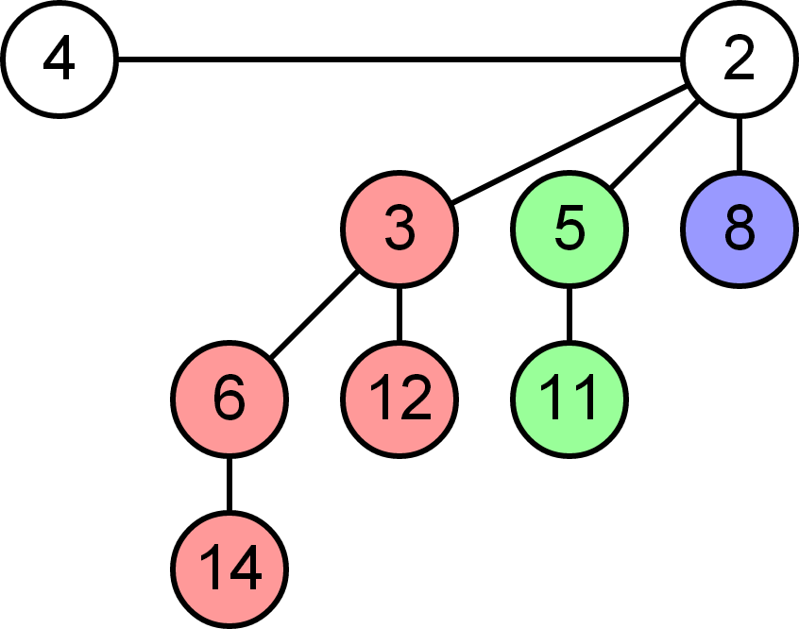
1. Union-Find Review
Better Solutions?
Use data structures that are better for merging!
Example:
Binomial Heap (logarithmic), Fibonacci Heap (amortized constant)

Slide 168
3. Divide-and-Conquer MST
New divide and conquer algo for MST:
1. Find the median edge weight w_{e}.
2. Partition the edges using the edges into those ≤ w_{e} and those > w_{e} into two graphs G_{a} and G_{b}.
3. Recursively find the MST for Ga and Gb, yielding trees T_{a} and T_{b}.
4. Combine the edges from T_{a} and T_{b}, and recursively find the MST for the resulting graph.

Slide 169
3. Divide-and-Conquer MST
How well do you think this algorithm works?
(What would happen if it continued to a base case of 1 edge?)

Slide 170
3. Divide-and-Conquer MST
1
A
B
B
2
3
C
C

Slide 171
3. Divide-and-Conquer MST
Find edge with median weight, w_{e} = 2
1
A
B
B
2
3
C
C

Slide 172
3. Divide-and-Conquer MST
Partition to $G_{A}=\{d:w_{d}≤w_{e}\}$ and $G_{B}=\{d:w_{d}>w_{e}\}$
1
A
B
B
2
3
C
C

Slide 173
3. Divide-and-Conquer MST
Partition to $G_{A}=\{d:w_{d}≤w_{e}\}$ and $G_{B}=\{d:w_{d}>w_{e}\}$
1
A
B
B
2
3
C
C

Slide 174
3. Divide-and-Conquer MST
Recursively find MST for $G_{A}$ and $G_{B}$
1
A
B
B
2
3
C
C

Slide 175
3. Divide-and-Conquer MST
Recursively find MST for $G_{A}$ and $G_{B}$
1
A
B
B
2
3
C
C

Slide 176
3. Divide-and-Conquer MST
Combine edges from G_{A} and G_{B}
1
A
B
B
2
3
C
C

Slide 177

3. Divide-and-Conquer MST
1
A
B
B
2
3
C
C

Slide 178
3. Divide-and-Conquer MST
If the number of edges in the graph E < 4V , then the recursion terminates and he uses Prim’s algorithm to find the MST
Why do you think this algorithm will return a valid MST (unlike the one we saw in lecture)?

Slide 179
3. Divide-and-Conquer MST
Why do you think this algorithm will return a valid MST (unlike the one we saw in lecture)?
When you find the recursive MST on a subset of the edges E’, every edge eliminated is a ”red edge”, i.e. an edge that is the heaviest edge on a cycle among the edges in E′; therefore it is clearly also the heaviest edge on a cycle among all the edges in E
So it is safe to eliminate edges from the MST when looking only at a subset of edges.

Slide 180

3. Divide-and-Conquer MST
Runtime Analysis:
- Find median (O(E) time through QuickSelect)
- Partition edges to 2 subgraphs
- After two recursive calls, at most 2V edges left in total
(since each MST has at most V-1 → O(V) edges)
$$T\left(V,E\right)=2T\left(V,\frac{E}{2}\right)+O\left(E\right)+T(V,2V)$$

Slide 181
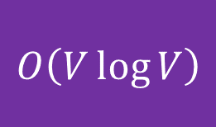
3. Divide-and-Conquer MST
Runtime Analysis:
Since base case states to run Prim’s algo when E < 4V,
T(V, 2V) is essentially the same as Prim’s Runtime Complexity!
Prim’s: O(E log V) = O(2V log V) → O(V log V)
$$T\left(V,E\right)=2T\left(V,\frac{E}{2}\right)+O\left(E\right)+T(V,2V)$$
$$O\left(V\log{V}\right)$$

Slide 182


3. Divide-and-Conquer MST
Runtime Analysis:
Since base case happens before V edges, recursion tree will have at most $\log{\frac{E}{V}}$levels, at most $\frac{E}{V}$ leaves and $\frac{2E}{V}$ nodes
Let k = levels, $\frac{E}{2^{k}}=4V, k=\log_{2}{\frac{E}{4V}}$
Hence,
→ Runtime for median = O(E $×$ $\log{\frac{E}{V}}$)
→ Runtime for MST = O($\frac{2E}{V}V\log{V}$) = O($E\log{V}$)
Total runtime: O($E\log{\frac{E}{V}}+E\log{V}$) $≈$ O($E\log{V}$)

Slide 183


5. Let’s Play A Game!

Slide 184










5. Let’s Play A Game!

Slide 185









5. Let’s Play A Game!

Slide 186



5. Let’s Play A Game!

Slide 187


5. Let’s Play A Game!

Slide 188
5. Let’s Play A Game!

Slide 189
5. Let’s Play A Game!
We want to maximise the total weight of all black edges in the MST. One way to find a good solution is to use the cut property of MSTs!

Slide 190









5. Let’s Play A Game!
E.g. Original Graph:

Slide 191









5. Let’s Play A Game!
Partition {A}, {B, C, D}

Slide 192
5. Let’s Play A Game!
We can add an edge < 6 here!

Slide 193

5. Let’s Play A Game!
Partition {B}, {A, C, D}

Slide 194

5. Let’s Play A Game!
Another edge < 6 here!

Slide 195
5. Let’s Play A Game!
Partition {A, C}, {B, D}

Slide 196

5. Let’s Play A Game!
Another edge < 6 here!

Slide 197

5. Let’s Play A Game!
Can stop here :)

Slide 198
5. Let’s Play A Game!
MST = 5 5 5 = 15 pts!

Slide 199
5. Let’s Play A Game!
However, do note that this solution is just a heuristic and the actual optimal solution is NP-hard!
→ Perhaps consider complete Search + minimax

Slide 200
6. Espionage
You need to encrypt your message by inserting additional edges (with integer weights) to your tree. The resulting graph, which represents the encrypted message, must satisfy the following properties:
The resulting graph is a complete graph of N vertices
The initial tree is the unique MST of the resulting graph.
The cost of the encryption process is defined as the sum of the weights of the additional edges that are inserted into the graph during the encryption process.
Given the initial message, which consists of the number of vertices in the tree, N, and a list of N − 1 edges of the tree, output the minimum possible cost of encrypting this message.

Slide 201
6. Espionage
1
16
0
12
2
3
7

Slide 202
6. Espionage
13 + 17 + 17 = 47
1
16
17
17
0
12
13
2
3
7

Slide 203
6. Espionage
How can we force an MST algorithm to choose these particular edges?
1
16
17
17
0
12
13
2
3
7

Slide 204
6. Espionage
Consider Kruskal’s algorithm
1
Third
16
Second
0
Chosen first
12
2
3
7

Slide 205
6. Espionage
Kruskal’s algorithm, 2nd step
C1
C2
12
1
2
0
7
3
Weight?

Slide 206
6. Espionage
Kruskal’s algorithm, 2nd step
C1
C2
12
1
2
0
7
3
12 + 1 = 13

Slide 207
6. Espionage
Kruskal’s algorithm, 2nd step
12 + 1 = 13
cost = 13
C1
C2
12
1
2
0
7
3
13

Slide 208
6. Espionage
Kruskal’s algorithm, 3rd step
cost = 13
C1
C2
0
16
12
2
1
13
7
3

Slide 209
6. Espionage
Kruskal’s algorithm, 3rd step
cost = 13
C1
C2
0
16
12
2
1
13
7
3

Slide 210
6. Espionage
Kruskal’s algorithm, 3rd step
cost = 13
C1
C2
+ 17 + 17
0
16
12
2
1
13
17
7
3
17

Slide 211
6. Espionage
Kruskal’s algorithm, 3rd step
+ 17 + 17
cost = 47
C1
C2
0
16
12
2
1
13
17
7
3
17

Slide 212
6. Espionage
Kruskal’s algorithm
C1
C2
w
A
C
How many edges to add?
D
B
E

Slide 213
6. Espionage
Kruskal’s algorithm
C1
C2
w
A
C
D
B
E
Size = 2
Size = 3

Slide 214
6. Espionage
Kruskal’s algorithm
C1
C2
w
A
C
D
B
E
5 edges
Size = 2
Size = 3

Slide 215
6. Espionage
Kruskal’s algorithm
C1
C2
w
A
C
D
B
E
s1*s2 - 1 edges
Size = s1
Size = s2

Slide 216
6. Espionage
Kruskal’s algorithm
C1
C2
w
A
C
w+1
w+1
w+1
D
w+1
B
w+1
E
Weight w+1
Size = s1
Size = s2
s1*s2 - 1 edges

Slide 217
6. Espionage
Kruskal’s algorithm
C1
C2
w
A
C
w+1
w+1
w+1
D
w+1
B
w+1
E
Total added cost = (s1 * s2 – 1) * (w + 1)
Weight w+1
s1*s2 - 1 edges
Size = s1
Size = s2

Slide 218
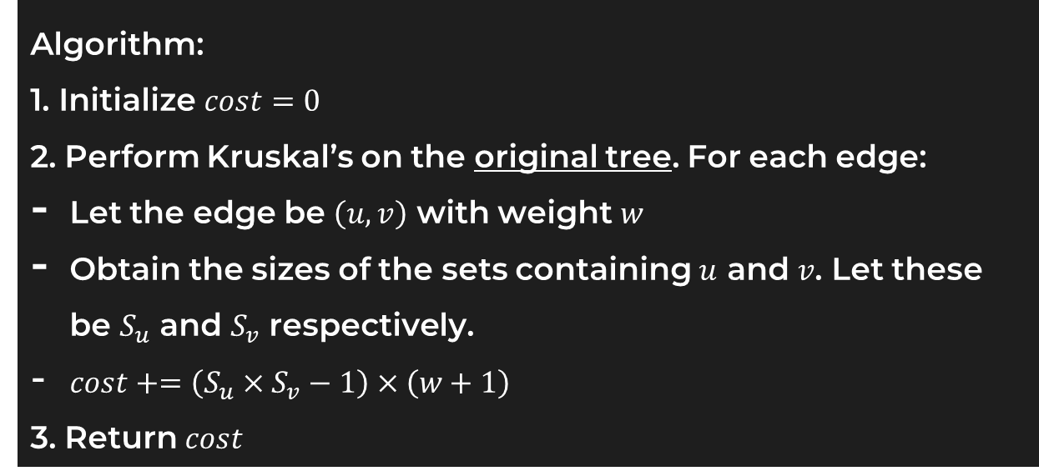
6. Espionage
Algorithm:
1. Initialize $cost=0$
2. Perform Kruskal’s on the original tree. For each edge:
Let the edge be $\left(u,v\right)$ with weight $w$
Obtain the sizes of the sets containing $u$ and $v$. Let these be $S_{u}$ and $S_{v}$ respectively.
$cost+=\left(S_{u}×S_{v}−1\right)×\left(w+1\right)$
3. Return $cost$

Slide 219
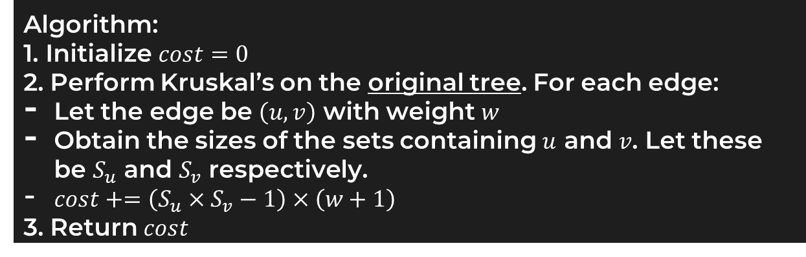
6. Espionage
Algorithm:
1. Initialize $cost=0$
2. Perform Kruskal’s on the original tree. For each edge:
Let the edge be $\left(u,v\right)$ with weight $w$
Obtain the sizes of the sets containing $u$ and $v$. Let these be $S_{u}$ and $S_{v}$ respectively.
$cost+=\left(S_{u}×S_{v}−1\right)×\left(w+1\right)$
3. Return $cost$
Runtime?
Bounded by Kruskal’s. Original graph has N vertices and N – 1 edges, so O(E log V) = O(N log N)

Slide 220
See you next week!

Slide 221
Credits
Goldenglow, Jackie Art:
Arknights Official Stickers

